Slide 1


Applied Data Science Capstone Project on
“Exploring venues in Aurangabad, Maharashtra, India
Using Foursquare and Zomato API” by
Suresh L.Ushalwar
May 27, 2020

Slide 2
Content
Introduction
Data Collection from APIs
Data Cleaning
Methodology
Analysis
Results and Discussion
Conclusion

Slide 3
Introduction
The aim of the project is to identify venues in Aurangabad, Maharashtra, India based on their rating and average prices
we will identify various venues in the city of Aurangabad, Maharashtra, India, using Foursquare API and Zomato API, to help visitors select the restaurants that suit them the best.
Here, we'll identify places that are fit for various individuals based on the information collected from the two APIs and Data Science.
Company can launch an application using the same data and suggest users such information.

Slide 4
Data Collection from APIs
We will also fetch the data from two different APIs.
Foursquare API: We will use the Foursquare API to fetch venues in Aurangabad starting from the middle up to 10 Kilometers in each direction.
Zomato API: The Zomato API provides information about various venues including the complete address, user ratings, price for two people, price range and a lot more.

Slide 5
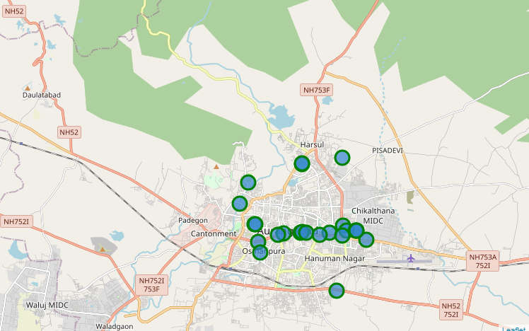
Data Cleaning
Foursquare data on the map.

Slide 6
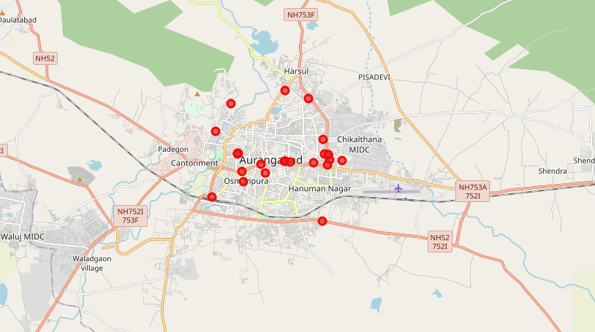
Data Cleaning
Zomato data on the map

Slide 7
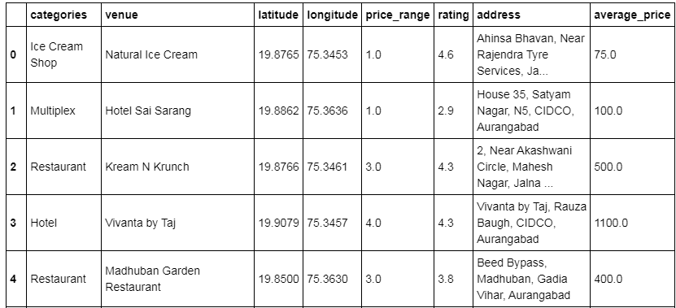
Data Cleaning
To combine the two datasets, I'll have to check that the latitude and longitude values of each corresponding venue match. Thus, I'll round both the latitude and longitude values up to 4 decimal places.
As a final dataset, we’re left with 21 venues with 8 columns .

Slide 8
Methodology and Exploratory Data Analysis
We will inspect these venues based on their rating. The rating of a venue are based on user reviews and belongs to a range from 1 to 5.
We'll also analyze the venues based on their price per person as well as the price rang.

Slide 9
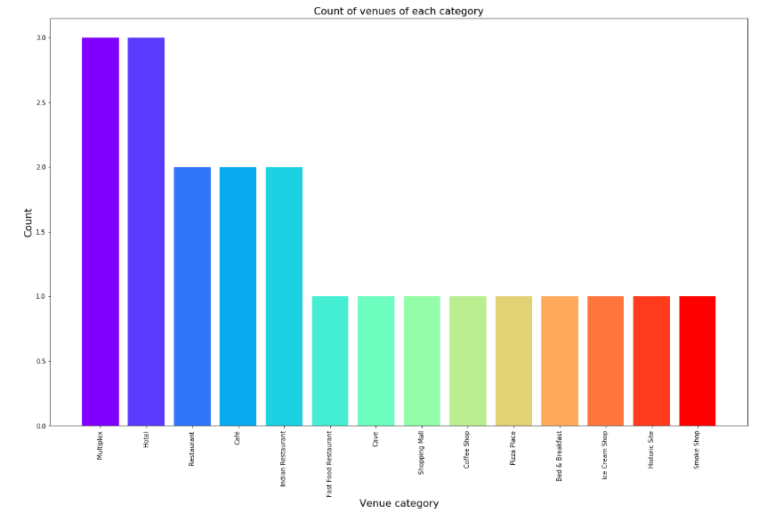
Methodology and Exploratory Data Analysis
  Categories
the majority venues are actually Multiplex & Hotels. This is closely followed by Restaurants. For someone who is visiting Aurangabad and loves either Cafes or Restaurants & multiplex, they’d surely love their stay.

Slide 10
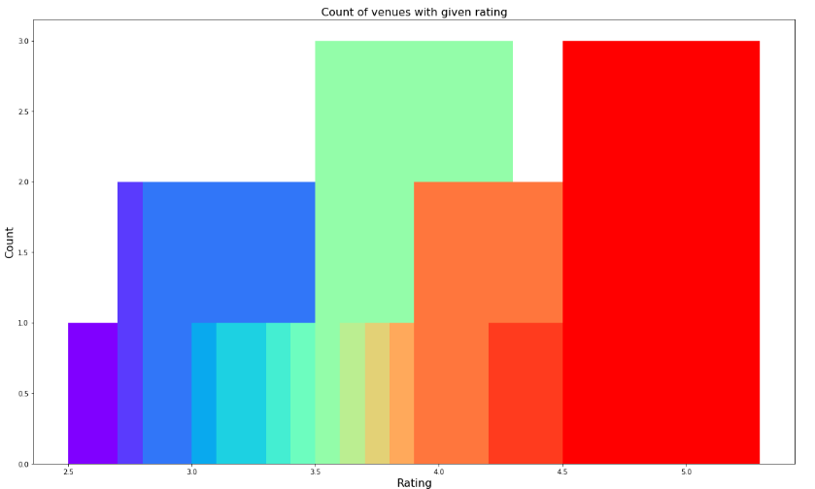
Methodology and Exploratory Data Analysis
  Rating
the average rating is spread across 3.5 to 4 with maximum number of venues scoring between 3 and 5

Slide 11
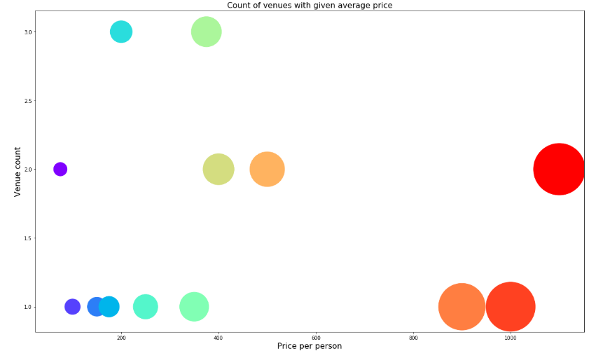
Methodology and Exploratory Data Analysis
Price
the majority venues have an average cost of Rs 200 to Rs 500 for one person

Slide 12
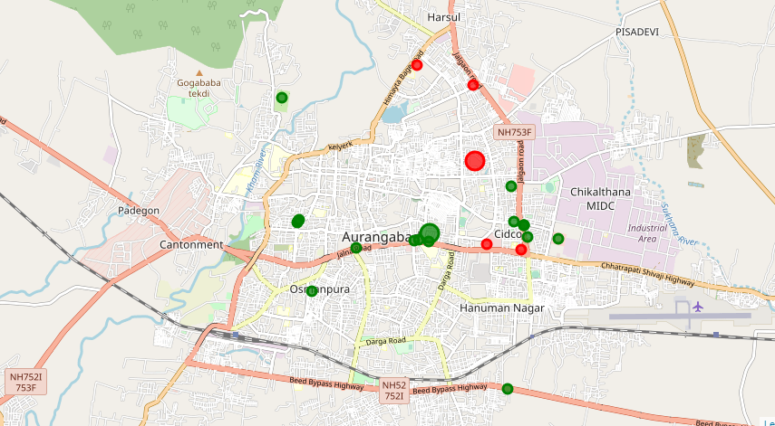
Clustering
used KMeans clustering and decided to cluster the venues into two separate groups.
The first cluster (green) is spread across the whole city and includes the majority
venues. These venues have mean price range of 2.18 and rating spread around 3.86.
The second cluster (red) is very sparsely spread and has very limited venues.
These venues have mean price range of 4.00 and rating spread around 4.02.

Slide 13
Results and Discussion
Based on our analysis above, we can draw a number of conclusions
  After collecting data from the Foursquare and Zomato APIs, we got a list of 26 different venues.
  We identified that from the total set of venues, majority of them were Multiplex, Hotels, Cafes and Restaurants.
  While the complete range of ratings range from 1 to 5, the majority venues have ratings between 3.5 to 4
  many venues have prices which are in the range of Rs 200 to Rs 500 for one person.
  Cidco and Akashwani are relatively priced lower than other venues in City. A high price exist in Rama International, Lemmon Tree & Taj Hotel.
  If you're looking for cheap places with relatively high rating, you should check Cidco & Akashwani.
  If you're looking for the best places, with the highest rating but might also carry a high price tag, you should visit Rama International, Lemmon Tree & Taj Hotel.
  If you're looking to explore the city and have no specific criteria to decide upon the places you want to visit, you should try Bibi ka Mukbara M & Ellora Caves.
  A company can use this information to build an online website/mobile application, to provide users with up to date information about various venues in the city based on the search criteria (name, rating and price).

Slide 14
Conclusion
The purpose of this project was to explore the places that a person visiting Aurangabad, Maharashtra, could visit.
The venues have been identified using Foursquare and Zomato API and have been plotted on the map.
The map reveals that there are Four major areas a person can visit: Cidco, Jalna Road to Akashwani , Ellora Caves and Bibi ka Mukbara.

Slide 15
Thank You!

